Slide 1





EXPLORING LEADERSHIP STYLES FOR INNOVATION <YEAR 2015 > by
Radhika Maini
Avneet Kaur
Kiran Vikram Anga
Satyam Vatts

Slide 2

Agenda
Introduction​
Exploring Leadership Styles​
Research Objectives
Dealing with the Data – Missing, Normality, Outliers
Understanding Participants – Demographic Profiles
Exploratory Factor Analysis
Correspondence Analysis
Further Exploration
Recommendations

Slide 3
Agenda
Introduction​
Exploring Leadership Styles​
Research Objectives
Dealing with the Data – Missing, Normality, Outliers
Understanding Participants – Demographic Profiles
Exploratory Factor Analysis
Correspondence Analysis
Further Exploration
Recommendations

Slide 4
Exploring leadership styles among Australian Managers
Leadership – an important factor of innovaton
Employee perceptions of well being and productivity
Ways to build a healthy working environment.

Slide 5
Agenda
Introduction​
Exploring Leadership Styles​
Research Objectives
Dealing with the Data – Missing, Normality, Outliers
Understanding Participants – Demographic Profiles
Exploratory Factor Analysis
Correspondence Analysis
Further Exploration
Recommendations

Slide 6
Transformational
Consideration
Autocratic
Bureaucratic
Transactional

Slide 7
Agenda
Introduction​
Exploring Leadership Styles​
Research Objectives
Dealing with the Data – Missing, Normality, Outliers
Understanding Participants – Demographic Profiles
Exploratory Factor Analysis
Correspondence Analysis
Further Exploration
Recommendations

Slide 8
Validating characteristics of Australian Managers and Supervisors based on leadership styles.
Significant leadership styles for innovation in the public sector in Australia
Perceptions about well being in 2014 vs 2015.
Employee impressions about immediate work group and supervisors : male/female
Productivity and ways of working in 2014 vs 2015

Slide 9
Agenda
Introduction​
Exploring Leadership Styles​
Research Objectives
Dealing with the Data – Missing, Normality, Outliers
Understanding Participants – Demographic Profiles
Exploratory Factor Analysis
Correspondence Analysis
Further Exploration
Recommendations

Slide 10
Handling Missing Data
Variable | Missing | Variable | Missing | Variable | Missing | Variable | Missing | Variable | Missing
AC1 | 0 | q20e | 690 | q24p | 2212 | q37b | 4017 | q58e | 3562
AS2 | 0 | q20f | 687 | q30 | 2121 | q37c | 4029 | q58f | 3647
q1 | 326 | q20g | 680 | q31 | 9015 | q37d | 4018 | q58g | 3619
q2 | 21 | q20h | 715 | q32 | 2174 | q37e | 4073 | q58h | 3610
q7@ | 0 | q20i | 728 | q33 | 2204 | q37f | 4097 | q58i | 3571
q8 | 158 | q21a | 940 | q34a | 3345 | q37g | 4178 | q58j | 3543
q18a | 503 | q21b | 951 | q34b | 4667 | q37h | 4238 | q59 | 3652
q18b | 506 | q21c | 981 | q35a | 2287 | q37i | 4254 | q60 | 3373
q18c | 529 | q21d | 1043 | q35b | 2283 | q37j | 4355 | q64c | 5074
q18d | 549 | q21e | 1053 | q35c | 2319 | q37k | 4286 | q67c | 3608
q18e | 537 | q21f | 1133 | q35d | 2291 | q37l | 4303 | q67d | 3652
q18f | 545 | q21g | 1098 | q35e | 2295 | q53b | 3092 | q67e | 3630
q19 | 502 | q21h | 1064 | q35f | 2283 | q53c | 3139
q20a | 621 | q21i | 1080 | q35g | 2346 | q58a | 3417
q20b | 648 | q21j | 1112 | q36a | 3750 | q58b | 3484
q20c | 708 | q24m | 2302 | q36b | 23967 | q58c | 3496
q20d | 669 | q24o | 2244 | q37a | 3964 | q58d | 3576
Max missing values in questions q36b with 24k missing values.
Missing completely at random- The reason being the respondents have not replied to certain questions .
Imputation can lead to biased dataset eventually distorting our analysis.
After removing missing values:
Number of Observations: 13065
Number of Variables selected: 84
Maini(10034257)

Slide 11
Normality And Outliers
The rule of thumb says, +/- 2.58 of skewness value can be approximately normal. The values of skewness range from 0.6 to -0.6
Kurtosis values range from 0.1 to -1.05, which are in the recommended range for the data to be normal.
Outliers are determined by calculating the absolute value of z-scores greater than 3.29 for each column.

Slide 12
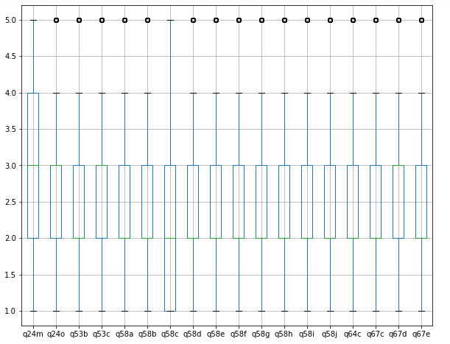
Boxplot illustrations for outliers
Some points as the outliers for all questions except 24m
Outliers shown in the boxplot are valid/accepted responses within the range of 1 to 5.

Slide 13
Descriptive Analysis
Question | Variable Description | mean | std | skew | kurtosis
q24m | Managers in Agency Encourage innovation | 3.05243 | 0.988803 | 0.120197 | -0.35805
q24o | Managers in Agency Value their Employees | 2.892155 | 1.029087 | 0.301296 | -0.32799
q53b | Supervisor provides with clear and consistent performance expectations | 2.580788 | 1.015758 | 0.71516 | -0.06279
q53c | Supervisor provides with a clear understanding of how performance is assessed and measured | 2.71902 | 1.040055 | 0.510637 | -0.39758
q58a | Achieves results | 2.207731 | 0.974107 | 0.901024 | 0.625164
q58b | Cultivates productive working relationships | 2.294757 | 1.090581 | 0.814811 | 0.05258
q58c | Exemplifies personal drive and integrity | 2.187294 | 1.062236 | 0.905549 | 0.337446
q58d | Shapes strategic thinking | 2.306008 | 1.057175 | 0.744029 | 0.080134
q58e | Communicates with influence | 2.326215 | 1.108189 | 0.772462 | -0.06143
q58f | Sets direction | 2.310142 | 1.040268 | 0.761358 | 0.170169
q58g | Motivates people | 2.470034 | 1.141226 | 0.614525 | -0.3451
q58h | Encourages innovation | 2.451665 | 1.101053 | 0.616668 | -0.21721
q58i | Develops people | 2.464524 | 1.139591 | 0.638294 | -0.30884
q58j | Is open to continued self-learning | 2.292461 | 1.041673 | 0.80151 | 0.327977
q64c | Immediate supervisor actively manages employees’ sick/carer’s leave | 2.441638 | 0.885765 | 0.720884 | 0.617496
q67c | Immediate supervisor takes responsibility when a problem is identified | 2.216686 | 0.943098 | 0.953707 | 0.899802
q67d | Senior leaders in agency take responsibility when a problem is identified | 2.767394 | 1.005881 | 0.399032 | -0.18329
q67e | People in agency are encouraged to speak up when they identify a serious policy or delivery risk | 2.561959 | 1.046606 | 0.692843 | -0.06657
Mean can tell the average opinion of the respondents.
The q24m , Managers were encouraging innovation as mean is 3 which denotes ‘Somewhat’.
Similar observation can be made for ‘valuing their employees’ as the average is near 3
Responses of the q53 b and c , there was a clear-cut communication between the supervisors and the respondents.
Regarding q58, supervisors were exhibiting the officer like qualities, and motivating their employees.
The responses of q64, supervisors strongly cared about their employees’ health and granted leaves in need.
q67 reflects that Managers and Supervisors take responsibility of the problems thus proving as inspiration for subordinates

Slide 14
Agenda
Introduction​
Exploring Leadership Styles​
Research Objectives
Dealing with the Data – Missing, Normality, Outliers
Understanding Participants – Demographic Profiles
Exploratory Factor Analysis
Correspondence Analysis
Further Exploration
Recommendations

Slide 15
Intuition
Response Rate – 66%
91,000 respondents
Impressions – workplace, leadership, job satisfaction and overall development
Validating conclusions for entire population

Slide 16
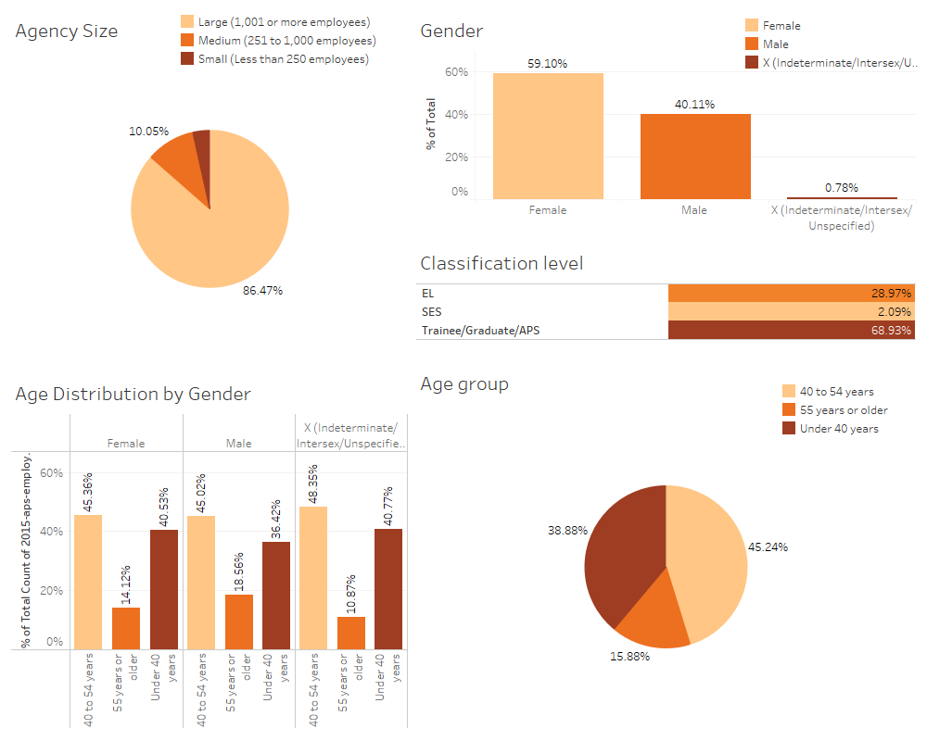

Slide 17
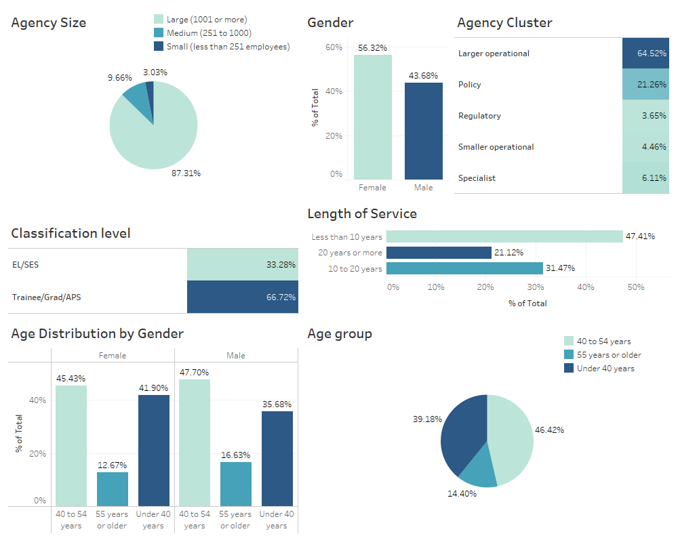
Demographic Analysis – Post Cleaning

Slide 18
ANOVA Test Differences in opinions of Managers and Subordinates
Variable | F - Ratio | p-value | Mean EL/SES | Mean Trainee/Grad/APS | Mean Diff | Interpretation
q24m | 2.198653845 | 0.138155443 | 3.034268629 | 3.061489044 | 0.027220415 | Opinion regarding encouragement on innovation doesn’t differ between managers and subordinates
q24o | 49.7153618 | 1.87E-12 | 2.802437902 | 2.936904898 | 0.134466996 | Significant difference of opinions exists between managers and subordinates about valuing the employees in their agency.
q53b | 2.23202585 | 0.13520066 | 2.599586017 | 2.571412183 | 0.028173833 | Opinion regarding clear performance expectations from supervisors doesn’t differ between managers and subordinates
q53c | 24.79726304 | 6.45E-07 | 2.783118675 | 2.687048296 | 0.096070379 | Significant difference of opinions exists between managers and subordinates about getting informed of performance assessment.
q58a | 85.72734874 | 2.38E-20 | 2.096366145 | 2.263278651 | 0.166912506 | Significant difference of opinions exists between managers and subordinates about leadership skills of immediate supervisors.
q58b | 55.47769007 | 1.00E-13 | 2.194342226 | 2.344843409 | 0.150501183
q58c | 109.5507838 | 1.55E-25 | 2.050137994 | 2.255707239 | 0.205569244
q58d | 126.9643145 | 2.58E-29 | 2.159153634 | 2.379258919 | 0.220105285
q58e | 62.93149158 | 2.31E-15 | 2.217571297 | 2.380406103 | 0.162834806
q58f | 56.56249878 | 5.80E-14 | 2.213431463 | 2.358380177 | 0.144948714
q58g | 22.5593914 | 2.06E-06 | 2.402943882 | 2.50349891 | 0.100555028
q58h | 57.27240323 | 4.05E-14 | 2.348666053 | 2.503040037 | 0.154373983
q58i | 36.78243419 | 1.36E-09 | 2.379024839 | 2.507169898 | 0.128145059
q58j | 44.01644019 | 3.38E-11 | 2.20699172 | 2.335092348 | 0.128100628
q64c | 0.841255769 | 0.3590548 | 2.451701932 | 2.436618103 | 0.015083829 | Significant difference of opinions exists between managers and subordinates about getting sick leaves from managers.
q67c | 30.70445212 | 3.06E-08 | 2.152023919 | 2.248938855 | 0.096914936 | Significant difference of opinions exists between managers and subordinates about taking responsibilities of a problem by supervisor.
q67d | 0.839096885 | 0.3596721 | 2.755979761 | 2.773087071 | 0.01710731 | Opinion regarding taking responsibilities of a problem by senior leaders doesn’t differ between managers and subordinates
q67e | 7.046166182 | 0.007953135 | 2.596366145 | 2.544797522 | 0.051568623 | Significant difference of opinions exists between managers and subordinates about speaking up on serious policy risks
Opinions regarding Innovation, clear performance expectations, taking responsibilities of a problem by senior leaders Do not differ among the Managers and Subordinates.
Opinions regarding Valuing employees, understanding of performance assessment, Leadership skills, Getting sick leaves , Speaking up on Policy risks Differ among Managers and Subordinates for their leaders.

Slide 19
Agenda
Introduction​
Exploring Leadership Styles​
Research Objectives
Dealing with the Data – Missing, Normality, Outliers
Understanding Participants – Demographic Profiles
Exploratory Factor Analysis
Correspondence Analysis
Further Exploration
Recommendations

Slide 20
Question Selection
Supervisor
Provides regular and constructive feedback
Works effectively with people from diverse backgrounds
Committed to workplace safety
Accepting of people from diverse backgrounds
Treats people with respect
Provides me with clear and consistent performance expectations
Provides me with a clear understanding of how my performance is assessed and measured
Achieves results
Actively manages employees’ sick/carer’s leave
Cultivates productive working relationships
Exemplifies personal drive and integrity
Shapes strategic thinking
Communicates with influence
Sets direction
Motivates people
Encourages innovation
Develops people
Is open to continued self-learning
Takes responsibility for an identified problem
Encourage innovation
Value their employees
People are encouraged to speak up when they identify a serious policy or delivery risk
Agency

Slide 21
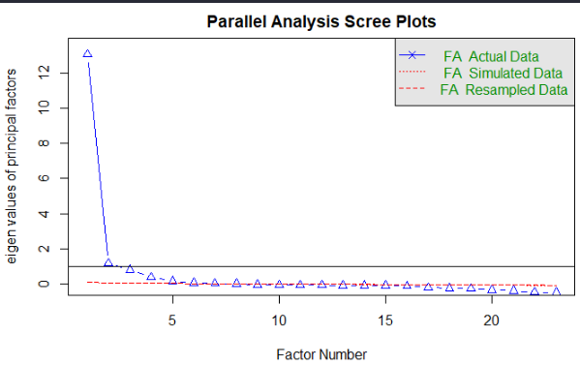
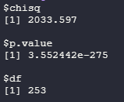
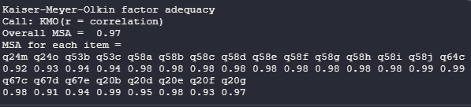
Data Validity - I
Bartlett Test
Existence of Correlation Between Variables
Oblimin Rotation
KMO Test
Sampling Adequacy>0.9
Suited for Factor Analysis
New Kaiser Criterion : Eigen Value>0.7
3 Factors

Slide 22
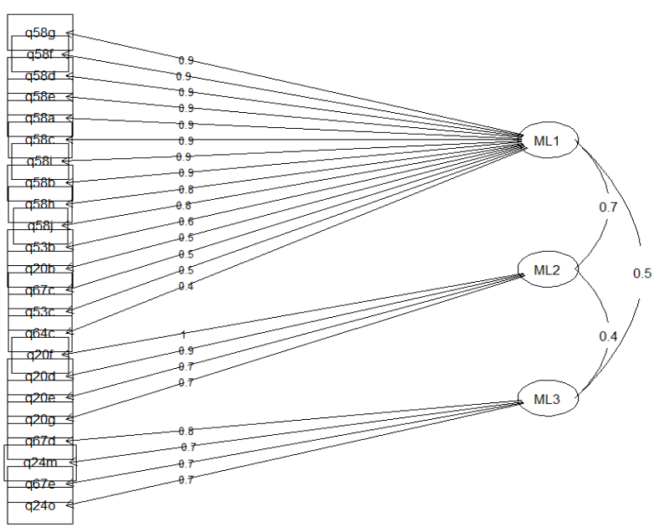
First Model : All In
ML1 | Q58, Q53, Q67,Q64 | High Loading: immediate supervisor action as leader Performance Management, code of conduct & caring by supervisor & agency
ML2 | Q20 | Accept and work with diverse people, commitment to workplace safety, treating people with respect
ML3 | Q64, Q24 | Taking responsibility, encouraging people and valuing employees by Agency

Slide 23
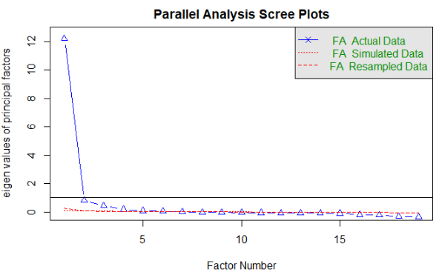
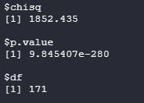
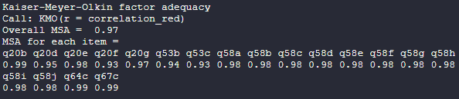
Data Validity - II
Bartlett Test
Existence of Correlation Between Variables
Oblimin Rotation
KMO Test
2 Factors
Sampling Adequacy>0.9 is considered great. Suited for Factor Analysis

Slide 24
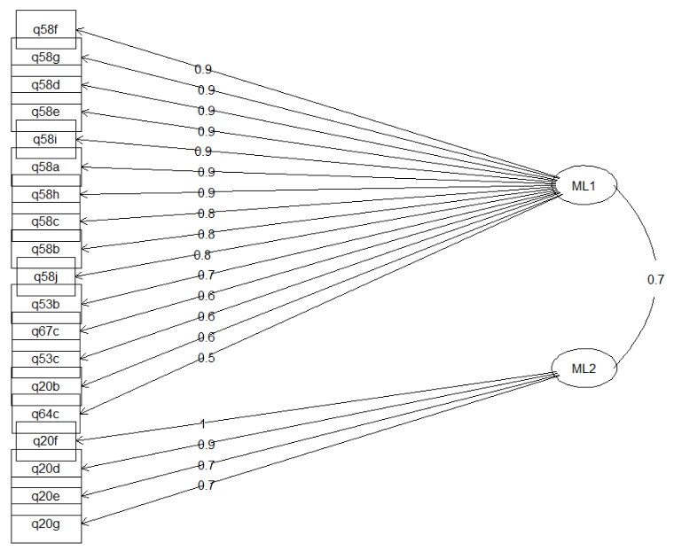
Second Model : Supervisors
ML1 | Transformational | Motivating, Encouraging innovation, developing achieving results, cultivating relationships, open to new ideas
ML2 | Consideration | Accept and work with diverse people, commitment to workplace safety, treating people with respect

Slide 25
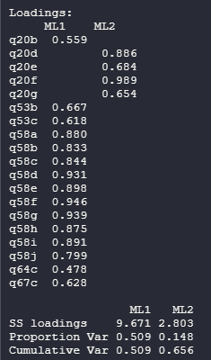
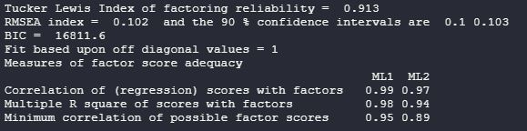
Model Accuracy
Simple structure – No double loadings
Cumulative Variance: 65%
RMSEA : 0.1 – Mediocre Fit
TLI > 0.9 indicating good fit

Slide 26
Agenda
Introduction​
Exploring Leadership Styles​
Research Objectives
Dealing with the Data – Missing, Normality, Outliers
Understanding Participants – Demographic Profiles
Exploratory Factor Analysis
Correspondence Analysis
Further Exploration
Recommendations

Slide 27
Objective
Employee Impressions : Immediate Workgroup & Supervisors
Perceptions about Wellbeing : 2014 vs 2015
Perceptions about Productivity & Ways of working : 2014 vs 2015

Slide 28
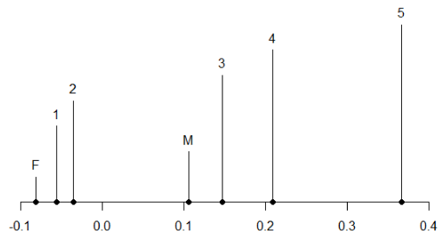
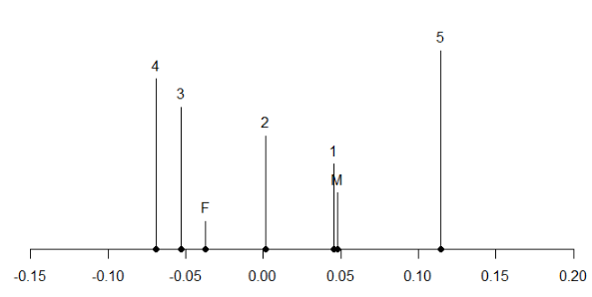
Employee Impressions : Immediate Workgroup
Male vs Females
Females have more clear understanding of workgroup’s role contributes to agency’s strategic direction than males
Males believe that people in workgroup are honest, open and transparent in their dealings while females don’t

Slide 29
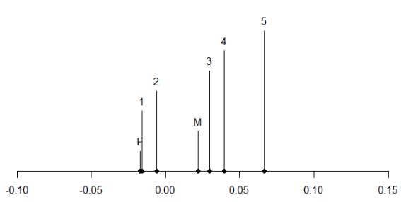
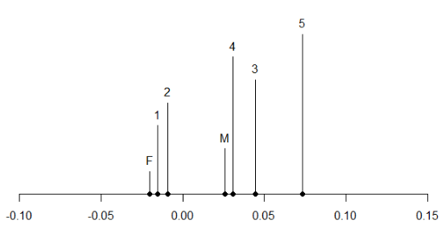
Employee Impressions : Immediate Supervisor
Male vs Females
Females witness supervisors working effectively with people from diverse backgrounds more than males
Females believe that supervisors are committed to workplace safety while males don’t

Slide 30
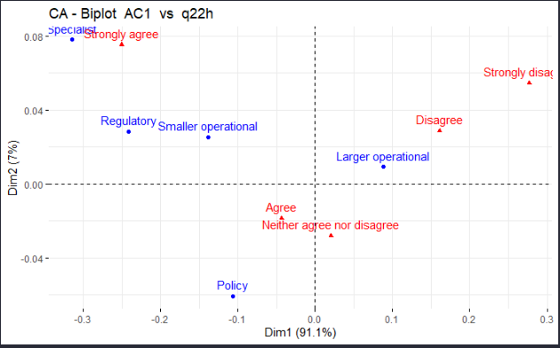
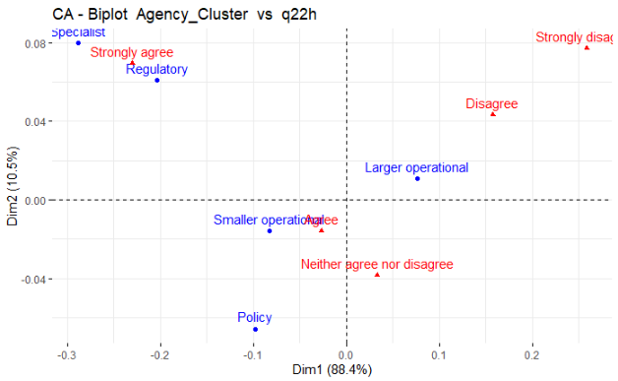
Perceptions about Wellbeing: 2014 vs 2015
2015
2014
Agency Cluster : Agency genuinely cares about employees being healthy and safe at work

Slide 31
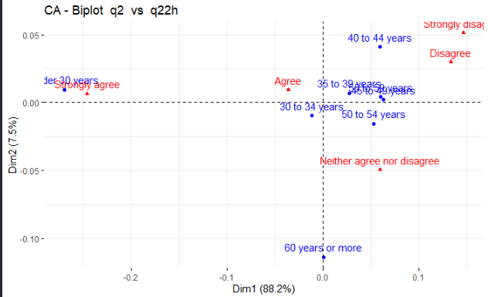
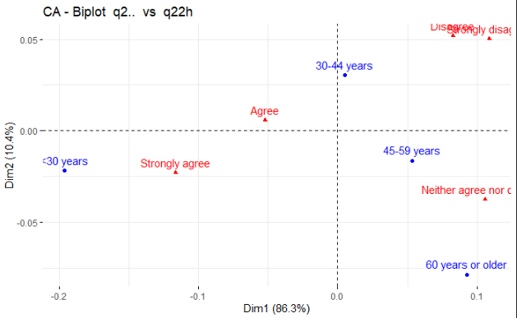
Perceptions about Wellbeing: 2014 vs 2015
2015
2014
Agency Cluster : Agency genuinely cares about employees being healthy and safe at work

Slide 32
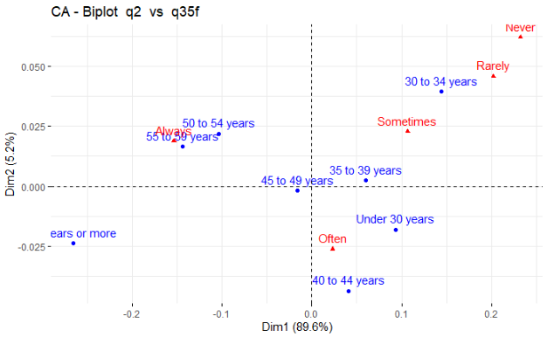
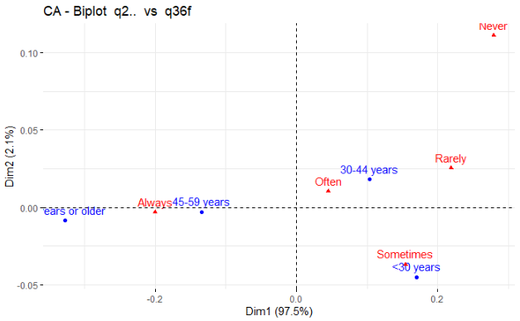
Perceptions about Wellbeing: 2014 vs 2015
2015
2014
Age Group: Clarity about duties and responsibilities

Slide 33
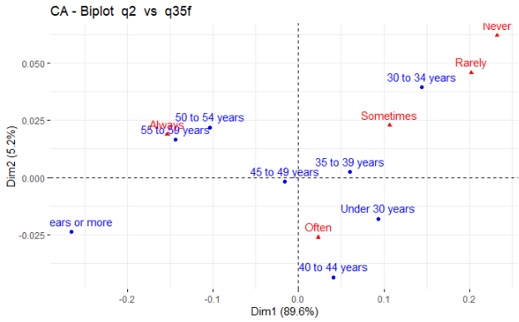
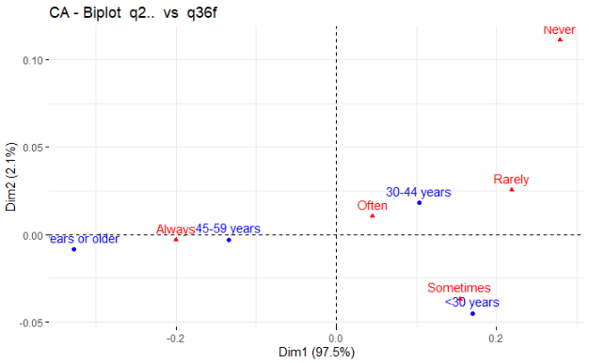
Productivity & Ways of Working: 2014 vs 2015
2015
2014
Age Group: Clarity about duties and responsibilities

Slide 34
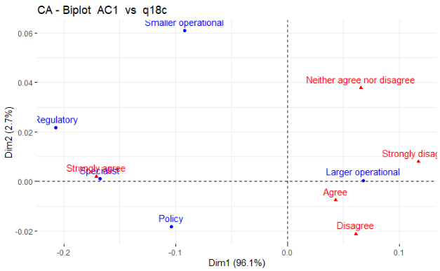
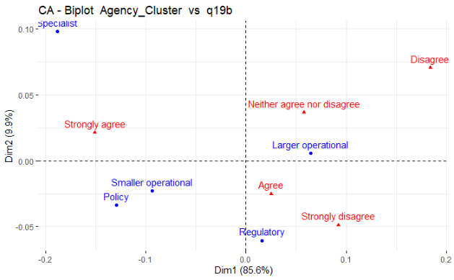
Productivity & Ways of Working: 2014 vs 2015
2015
2014
Agency Cluster: Cooperation in work to complete jobs

Slide 35
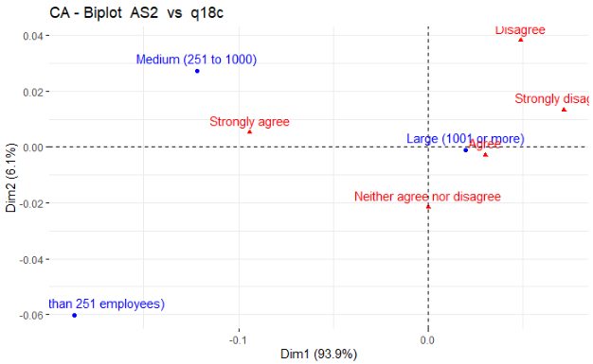
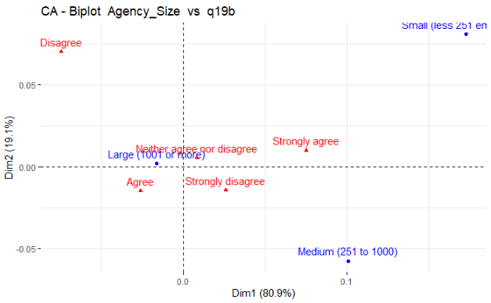
Productivity & Ways of Working: 2014 vs 2015
2015
2014
Agency Size: Cooperation in work to complete jobs

Slide 36
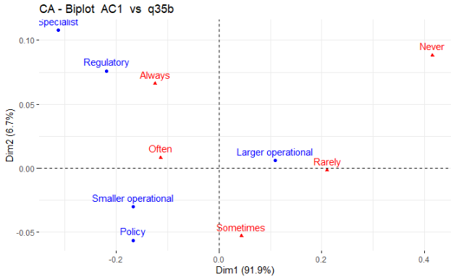
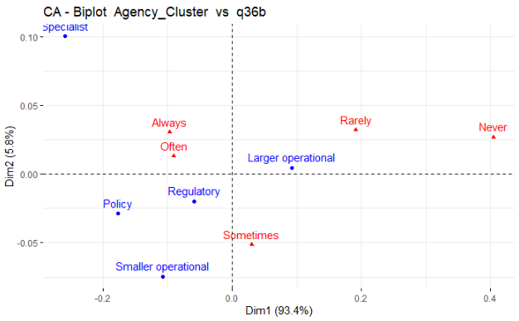
Productivity & Ways of Working: 2014 vs 2015
2015
2014
Agency Cluster: Choice of deciding way of working

Slide 37
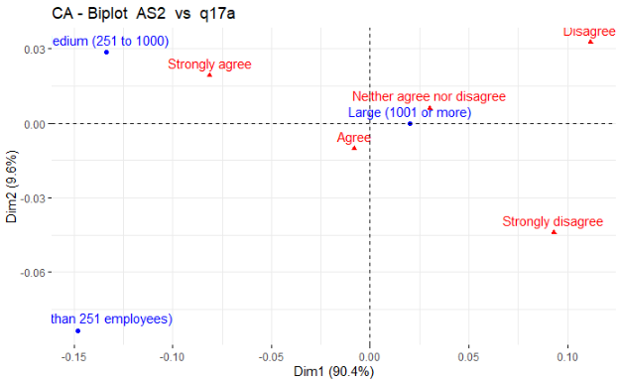
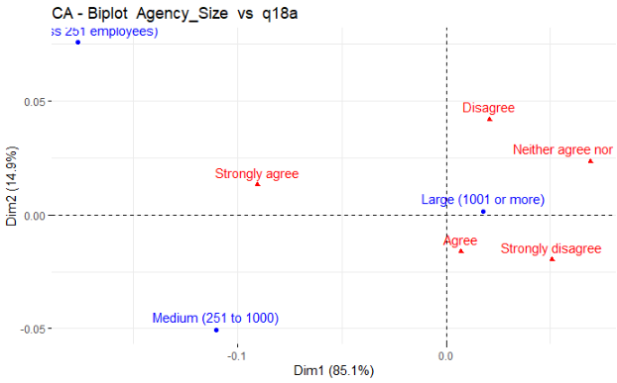
Productivity & Ways of Working: 2014 vs 2015
2015
2014
Agency Size: Enjoy working in current job

Slide 38
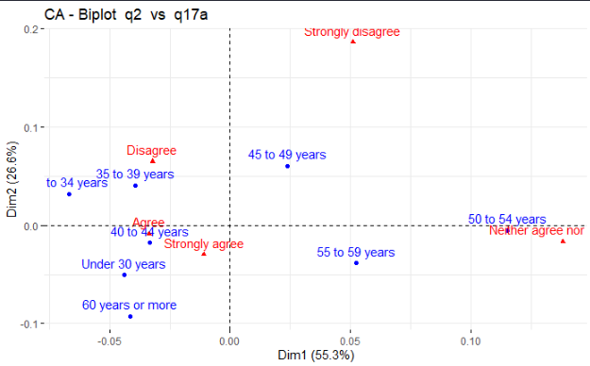
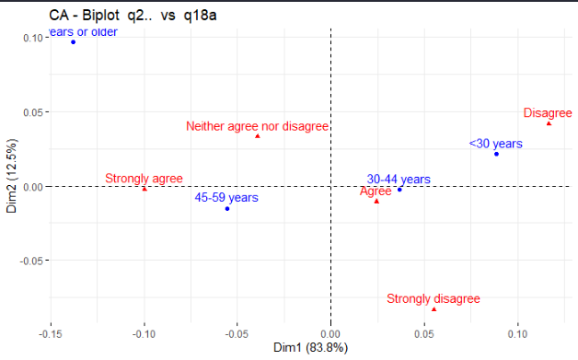
Productivity & Ways of Working: 2014 vs 2015
2015
2014
Enjoy working in current job

Slide 39
Agenda
Introduction​
Exploring Leadership Styles​
Research Objectives
Dealing with the Data – Missing, Normality, Outliers
Understanding Participants – Demographic Profiles
Exploratory Factor Analysis
Correspondence Analysis
Further Exploration
Recommendations

Slide 40
Calculating Index Scores – Well Being
Questions asked – 5-point agreement scale
To calculate index – recoded to scale of 10
Recoded responses – averaged across the selected questions for individual respondants

Slide 41
Questions selected from years 2014 and 2015
My agency genuinely cares about employees being healthy and safe at work
My agency supports employees who are injured or become ill due to work
The wellbeing of our people is important
Considering your work and life priorities, how satisfied are you with the work-life balance in your current job
I have unrealistic time pressures
I have a choice in deciding how I do my work
I am clear what my duties and responsibilities are

Slide 42
Results
The Wellbeing Index increased slightly from 53% in 2014 to 55% in 2015
Trainees had slightly better Wellbeing Index than managers for both the years

Slide 43
Employee Engagement
Refers to job satisfaction, commitment to the organisation, and the extent to which the employees are motivated or inspired
Strongly associated towards increased productivity and performance

Slide 44
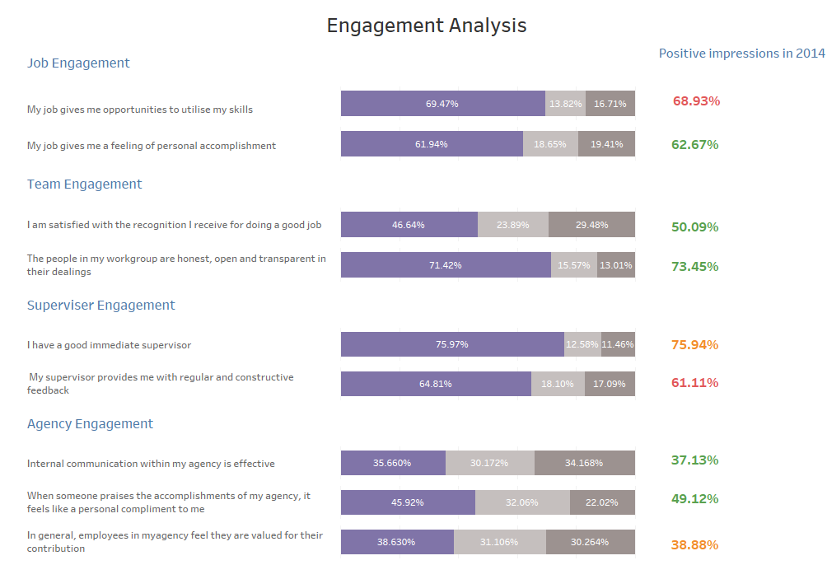
Notes:
Control + Click to follow link to Dashboard

Slide 45
Agenda
Introduction​
Exploring Leadership Styles​
Research Objectives
Dealing with the Data – Missing, Normality, Outliers
Understanding Participants – Demographic Profiles
Exploratory Factor Analysis
Correspondence Analysis
Further Exploration
Recommendations

Slide 46
Supervisors should follow a gender equality in terms of their behavior towards employees.
Larger Operational Agencies should develop more services and policies for taking care of wellbeing of the employees particularly for employee of more than 40 years of age
Supervisors & agencies should develop well-structured plans and orientations for new hires and less experienced employees.
Large Operational Agencies should device a structure that allows employees to clearly understand requirements and then have freedom to perform duties in their own ways.
The Agencies & Supervisors should work on strategies of engaging with their employees in order to increase productivity.

Slide 47

Thank You

